Slide 1
Applied Arduino Programming for neurophysiology
(supplementary materials)
Mike Sintsov
Head of Man-Machine Interfaces
at Motorica LLC

Slide 2
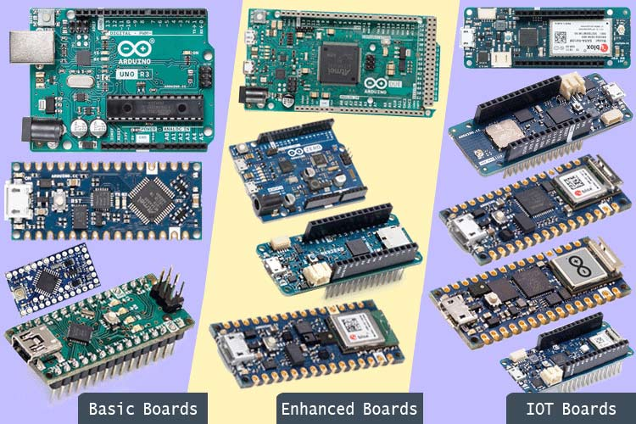
What is Arduino?
Company
Platform (both, hardware + software)
Workstyle … not a good one (toxic DIY)

Slide 3
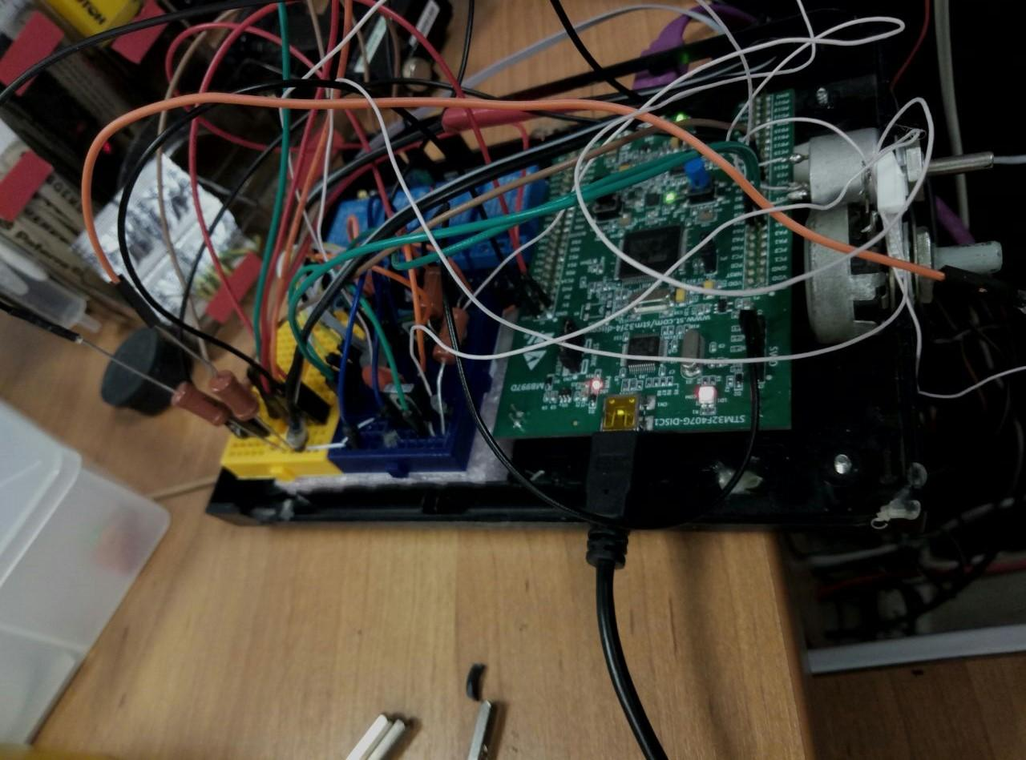

Toxic DIY

Slide 4
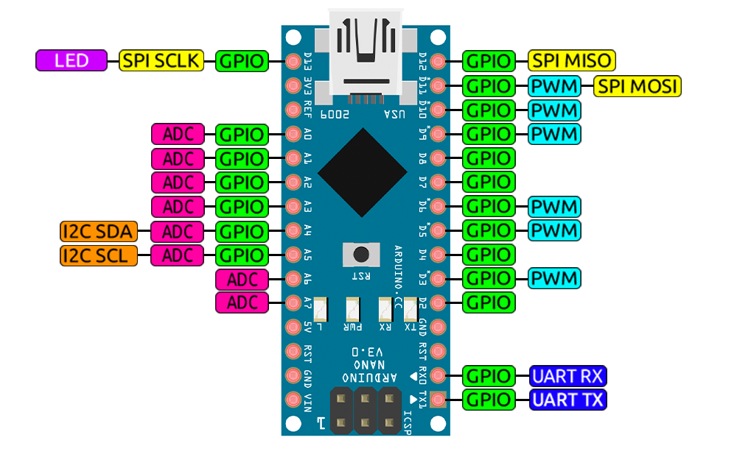
What should we use Arduino for?
PC-Hardware communication
Collecting data
Synchronizing with external hardware (PC or amplifier)
Producing stimuli
Tactile
Visual
Audial
Install EasyEDA for schematic design
We will work with Arduino Nano V3

Slide 5
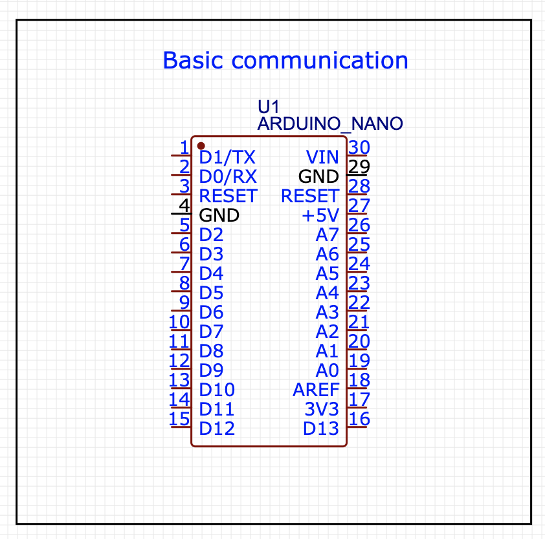
PC-Hardware communication
Download and install Arduino Studio
Connect to PC
Flash blink example
Flash serial example
UART is not instantaneous!!!
Try echo loop

Slide 6
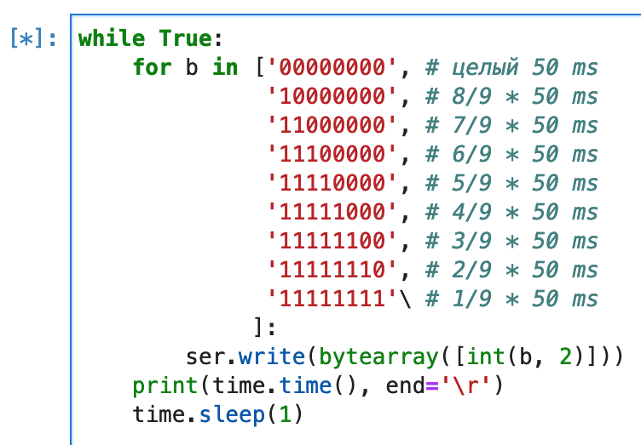
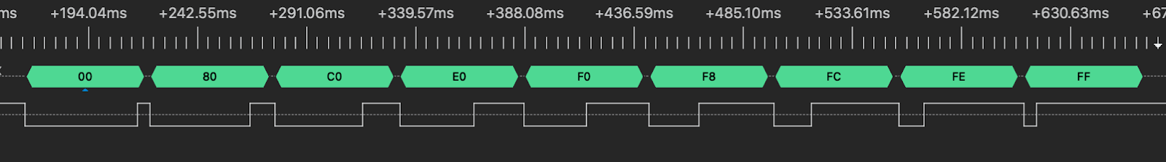
What is Boudrate?

Slide 7
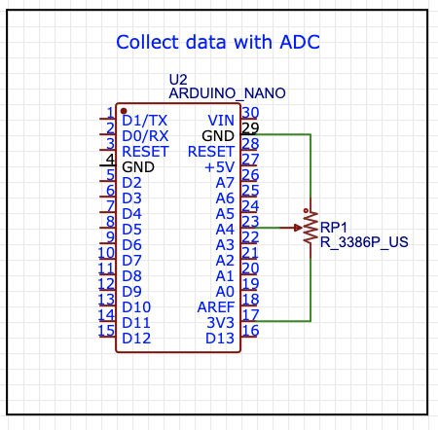
Collect data with analog to digital converter (ADC)
Learn how to work with Serial Monitor and Serial Plotter

Slide 8
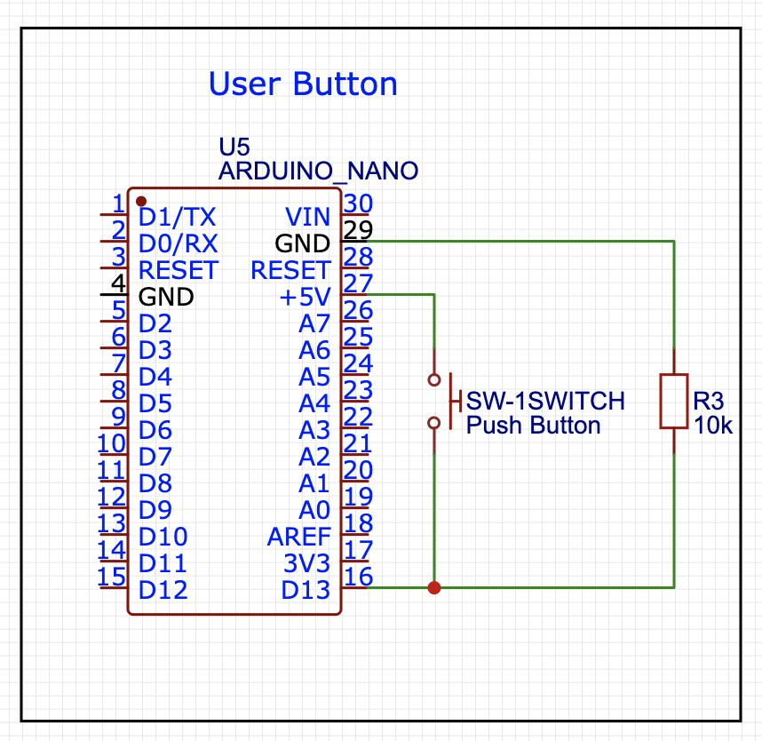
User Button
Mind pull-down (or pull-up) resistor
Mind jittering effects (software)

Slide 9
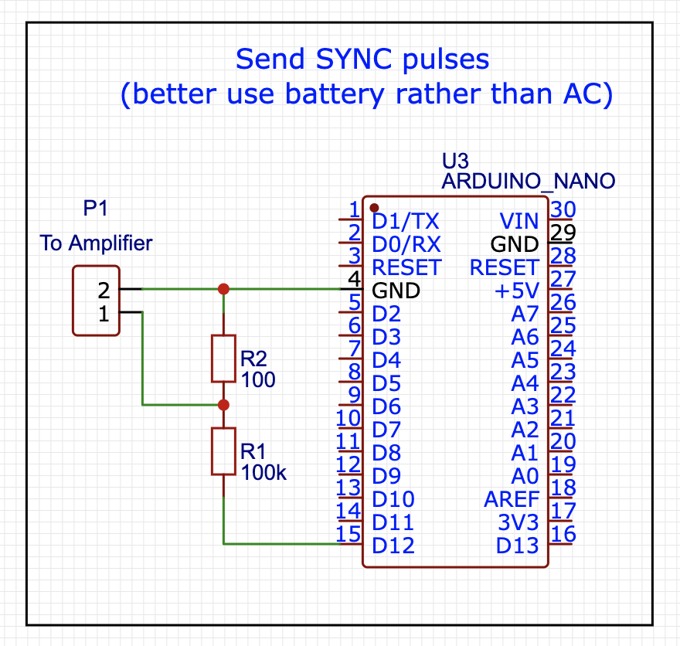
Send Synchropulses to Hardware

Slide 10
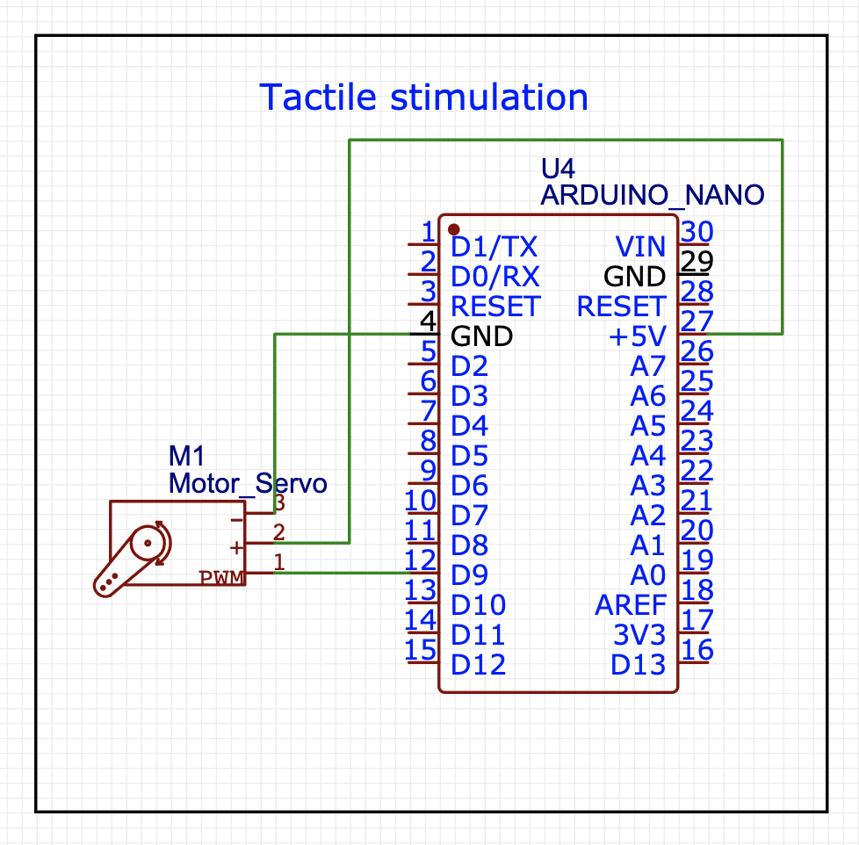
Stimuli: Tactile

Slide 11
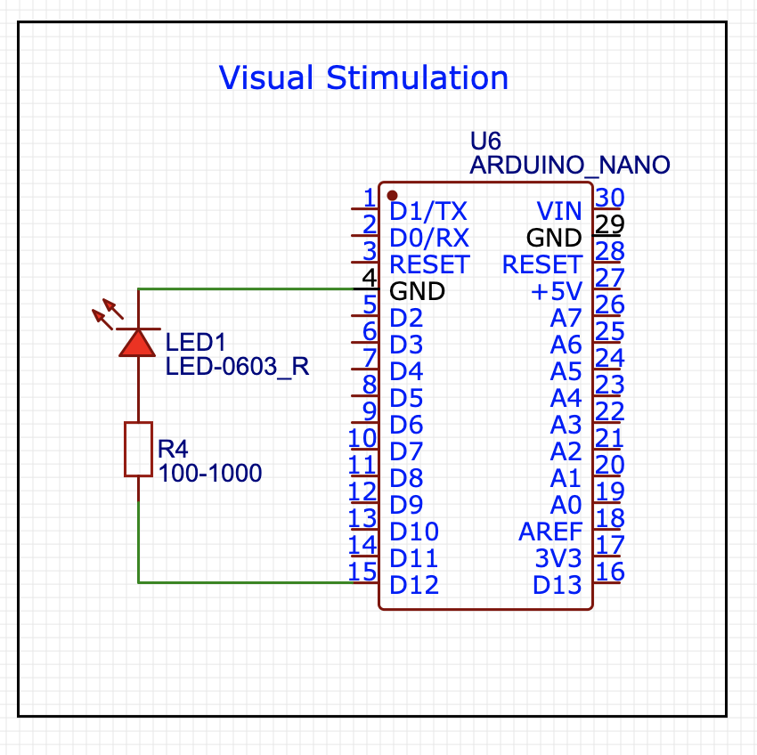
Stimuli: Visual

Slide 12
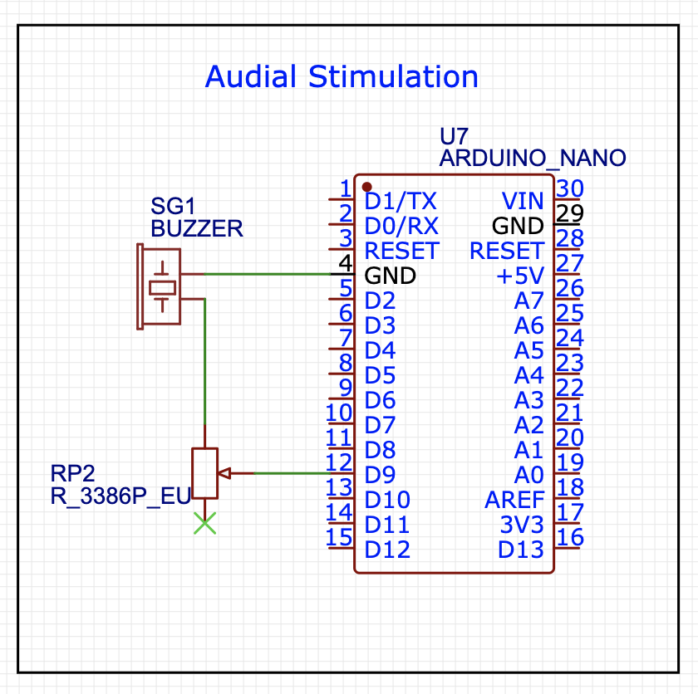
Stimuli: Audial
Be gentle — use potentiometer to decrease buzzer volume

Slide 13
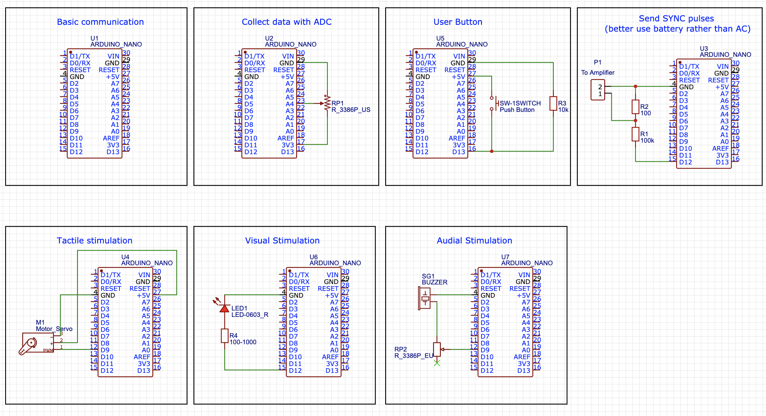
Don’t be afraid of trials and errors

Slide 14
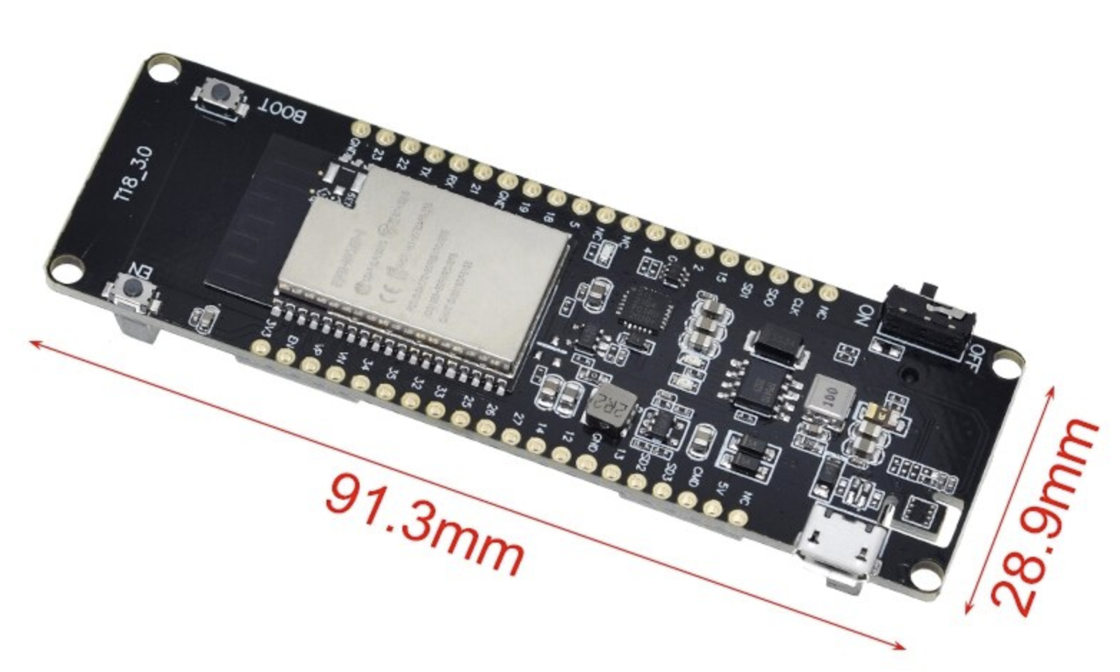
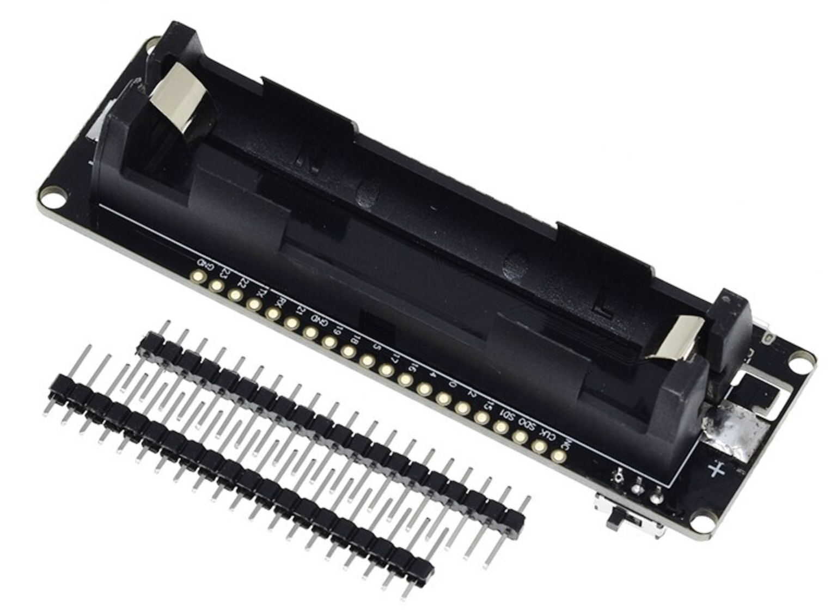
Additional information
Learn to build Arduino-Arduino communication: https://iot-guider.com/arduino/serial-communication-between-two-arduino-boards/
Also look at wireless boards of ESP32-Wrover-xx

